Slide 1
ASP.NET Core and RESTful Service

Slide 2
Objectives
Hypertext Transfer Protocol
Representational State Transfer (REST)
RESTful Web Service
Introducing ASP.NET Core RESTful Services
ASP.NET Core HTTP Verbs
Controller Actions with RESTful Services
Running OWIN middleware in ASP.NET Core pipeline

Slide 3
Hypertext Transfer Protocol (HTTP)
A communications protocol
Allows retrieving inter-linked text documents (hypertext)
World Wide Web.
HTTP Verbs
HEAD
GET
POST
PUT
DELETE
TRACE
OPTIONS
CONNECT
GET /index.html HTTP/1.1
Host: www.university.edu
Browser
Web Server
HTTP/1.1 200 OK
Content-Type: text/html
<html><head>…

Slide 4
HTTP Request-response format
Request consists of
Request line, such as GET /images/logo.gif HTTP/1.1, which requests a resource called /images/logo.gif from server.
Headers, such as Accept-Language: en
An empty line
An optional message body
Response consists of
Status line which includes numeric status code and textual reason phrase
Response headers
An empty line
The requested content

Slide 5
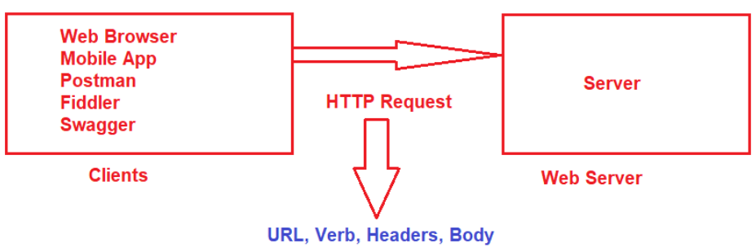
HTTP Request Components
URL: Each Request must have a unique URL
Verb (Method): Each Request must have an HTTP Verb.
Header(s): Each Request can contain one or more Headers.
Body: Each request can have a body. The body contains the data that we want to send to the server.

Slide 6
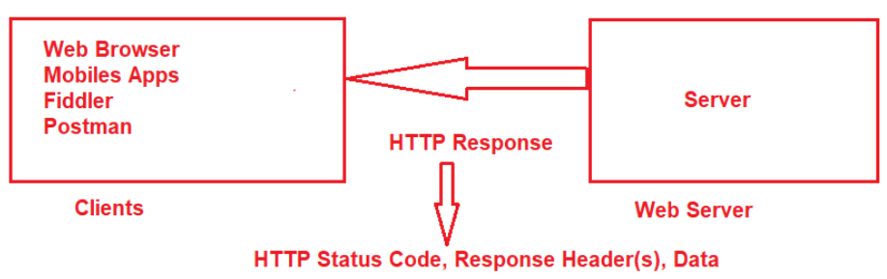
HTTP Response Components
HTTP Status Code: It must have a Status Code.
Response Headers: It can have one or more response headers.
Data: Response can have data i.e. return to the client.

Slide 7
HTTP Status Codes
The Status code is issued from the server and they give information about the response.
1XX: Informational Response
2XX: Successful, whenever you get 2XX as the response code, it means the request is successful.
3XX: Redirection, whenever you get 3XX as the response code, it means it is re-directional i.e. some re-directional is happening on the server.
4XX: Client Error, whenever you get 4XX as the response code, it means there is some problem with your request.
5XX: Server Error. Whenever you get 5XX as the response code, it means there is some problem in the server.

Slide 8
REST
REST stands for Representational State Transfer
It is an architectural pattern for developing web services as opposed to a specification
REST web services communicate over the HTTP specification, using HTTP vocabulary
Methods (GET, POST, etc.)
HTTP URI syntax (paths, parameters, etc.)
HTTP Response codes.
Media types (xml, json, html, plain text, etc)

Slide 9
Major REST principles - 1
Information is organized in the form of resources
Sources of specific information,
Referenced with a global identifier (e.g., a URI in HTTP).
Components of the network (user agents and origin servers) communicate via a standardized interface (e.g., HTTP)
exchange representations of these resources (the actual documents conveying the information).

Slide 10
Major REST principles - 2
Any number of connectors (e.g., clients, servers, caches, tunnels, etc.) can mediate the request, but each does so without being concern about anything but its own request
an application can interact with a resource by knowing two things: the identifier of the resource and the action required
no need to know whether there are caches, proxies, gateways, firewalls, tunnels, or anything else between it and resource
The application needs to understand the format of the information (representation) returned.

Slide 11
Characteristics of a REST based network
Client-Server: a pull-based interaction style(Client request data from servers as and when needed).
Stateless: each request from client to server must contain all the information necessary to understand the request, and cannot take advantage of any stored context on the server.
Cache: to improve network efficiency, responses must be capable of being labeled as cacheable or non-cacheable.
Uniform interface: all resources are accessed with a generic interface (e.g., HTTP GET, POST, PUT, DELETE).
Named resources - the system is comprised of resources which are named using a URL.
Interconnected resource representations - the representations of the resources are interconnected using URLs, thereby enabling a client to progress from one state to another.

Slide 12
RESTful Web Service definition
A RESTful Web service is:
A set of Web resources.
Interlinked.
Data-centric, not functionality-centric.
Machine-oriented.
Like Web applications, but for machines.
Like WS-*, but with more Web resources (WS-* stands for a variety of specifications related to SOAP-based Web Services).

Slide 13
Principles of RESTful web service design - 1
1.Identify all the conceptual entities that we wish to expose as services. (Resources such as : parts list, detailed part data, purchase order)
2. Create a URL to each resource.
3. Categorize our resources according to whether clients can just receive a representation of the resource (using an HTTP GET), or whether clients can modify (add to) the resource using HTTP POST, PUT, and/or DELETE).
4. All resources accessible via HTTP GET should be side-effect free. That is, the resource should just return a representation of the resource. Invoking the resource should not result in modifying the resource.

Slide 14
Principles of RESTful web service design - 2
5.Put hyperlinks within resource representations to enable clients to drill down for more information, and/or to obtain related information.
6. Design to reveal data gradually. Don't reveal everything in a single response document. Provide hyperlinks to obtain more details.
7. Specify the format of response data using a schema (DTD, W3C Schema, RelaxNG, or Schematron). For those services that require a POST or PUT to it, also provide a schema to specify the format of the response.
8. Describe how our services are to be invoked using either a WSDL document, or simply an HTML document.

Slide 15
Introducing ASP.NET Core RESTful Services
ASP.NET Web API, from the beginning, was designed to be a service-based framework for building REpresentational State Transfer (RESTful) services.
It is based on the MVC framework minus the V (view), with optimizations for creating headless services.
Calls to a Web API service are based on the core HTTP verbs (Get, Put, Post, Delete) through a uniform resource identifier (URI).
Calls to Web API use the Hypertext Transfer Protocol (HTTP) scheme on a particular host on a specific port, followed by the path and an optional query and fragment.

Slide 16
Reasons for choosing .NET for Web Services - 1
Use .NET for your server application or service when:
You have cross-platform needs.
If your web or service application needs to run on multiple platforms, for example, Windows, Linux, and macOS, use .NET.
You're targeting microservices.
A microservices architecture allows a mix of technologies across a service boundary. This technology mix enables a gradual embrace of .NET for new microservices that work with other microservices or services.
You need side-by-side .NET versions per application.
This side-by-side installation allows multiple services on the same server, each of them on its own version of .NET.

Slide 17
Reasons for choosing .NET for Web Services - 2
Use .NET for your server application or service when:
You're using Docker containers.
Containers are commonly used in conjunction with a microservices architecture. Containers can also be used to containerize web apps or services that follow any architectural pattern. .NET Framework can be used on Windows containers, but the modularity and lightweight nature of .NET makes it a better choice for containers.
You need high-performance and scalable systems.
When your system needs the best possible performance and scalability, .NET and ASP.NET Core are your best options. The high-performance server runtime for Windows Server and Linux makes ASP.NET Core a top performing web framework on TechEmpower benchmarks
Notes:
https://www.techempower.com/benchmarks/#hw=ph&test=plaintext

Slide 18
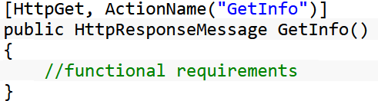
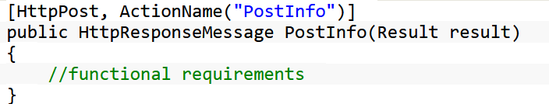
ASP.NET Core HTTP Verbs - 1
GET - As the name specifies, this verb is used to retrieve the data or information. It does not have any other effect except getting data.
POST - This verb is used to generate or create the resource. For example, If we have to add some information to the database then we must define the method as a POST method. The most common form to submit the data into the POST method is to pass the data into any entity object.

Slide 19
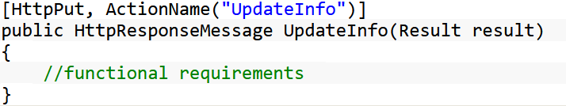
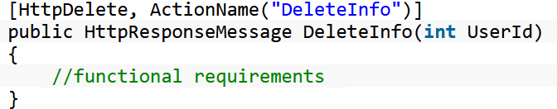
ASP.NET Core HTTP Verbs - 2
PUT - This verb is used to update the existing resource. For example, If we have to update some information to the database then we can define the method as a PUT method. We can send the data in the form of object as well as in a parameter
DELETE - This verb is used to delete the existing resource. For example, If we have to delete some information to the database then we can define the method as a DELETE method. We can send the data in the form of object as well as in a parameter too. too.

Slide 20
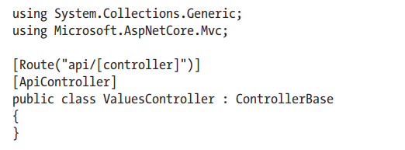
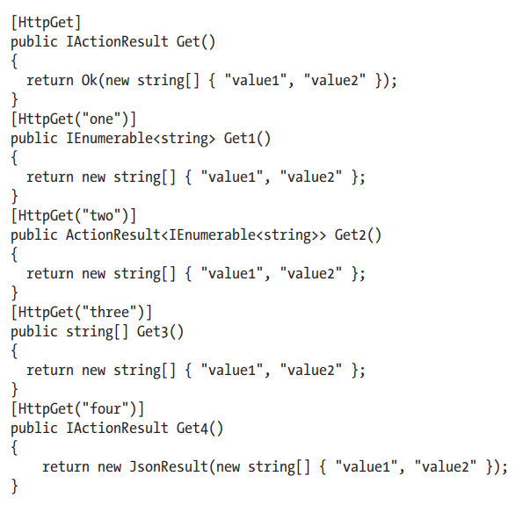
Controller Actions with RESTful Services
APIs also use HTTP status codes to communicate success or failure.
Formatted JSON Response Results

Slide 21
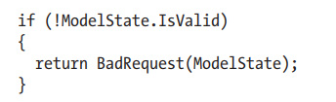
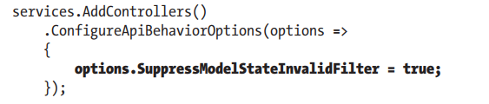
The ApiController Attribute
Attribute Routing Requirement
When using the ApiController attribute, the controller must use attribute routing.
Automatic 400 Responses
ASP.NET Core uses the ModelStateInvalidFilter action filter to do the preceding check. When there is a binding or a validation error, the HTTP 400 response in the body includes details for the errors.
This behavior can be disabled through configuration in the ConfigureServices()

Slide 22
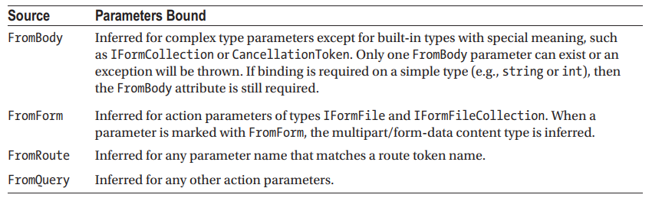
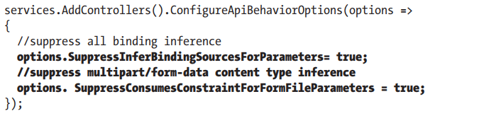
Binding Source Parameter Inference
This behavior can be disabled through configuration in the ConfigureServices() method.

Slide 23
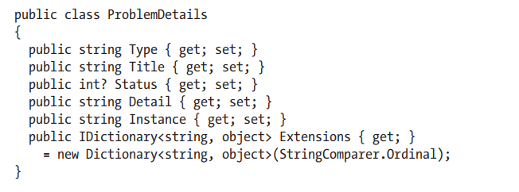
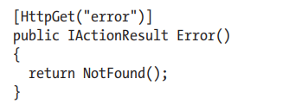
Problem Details for Error Status Codes
ASP.NET Core transforms an error result (status of 400 or higher) into a result with ProblemDetails.

Slide 24
Building API Action Methods
The Constructor
The Get Methods
The UpdateOne Method
The AddOne Method
The DeleteOne Method

Slide 25
Open Web Interface for .NET with ASP.NET Core - 1
ASP.NET Core:
Supports the Open Web Interface for .NET (OWIN).
Has .NET Core compatible replacements for the Microsoft.Owin.* (Katana) libraries.
OWIN allows web apps to be decoupled from web servers.
It defines a standard way for middleware to be used in a pipeline to handle requests and associated responses.
ASP.NET Core applications and middleware can interoperate with OWIN-based applications, servers, and middleware.

Slide 26
Open Web Interface for .NET with ASP.NET Core - 2
OWIN provides a decoupling layer that allows two frameworks with disparate object models to be used together. The Microsoft.AspNetCore.Owin package provides two adapter implementations:
ASP.NET Core to OWIN
OWIN to ASP.NET Core
This allows ASP.NET Core to be hosted on top of an OWIN compatible server/host or for other OWIN compatible components to be run on top of ASP.NET Core.

Slide 27
Running OWIN middleware in ASP.NET Core pipeline
ASP.NET Core’s OWIN support is deployed as part of the Microsoft.AspNetCore.Owin package.
You can import OWIN support into your project by adding this package as a dependency:
"dependencies": {
"Microsoft.AspNetCore.Server.IISIntegration": "1.0.0",
"Microsoft.AspNetCore.Server.Kestrel": "1.0.0",
"Microsoft.AspNetCore.Owin": "1.0.0"
},

Slide 28
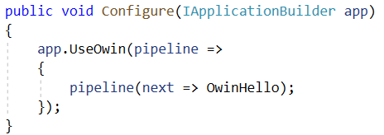
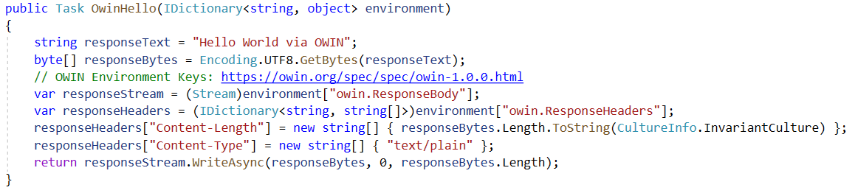
Running OWIN middleware in ASP.NET Core pipeline
OWIN middleware conforms to the OWIN specification, which requires a Func<IDictionary<string, object>, Task> interface, and specific keys be set (such as owin.ResponseBody).
The following simple OWIN middleware displays “Hello World”

Slide 29
Summary
Concepts were introduced:
Hypertext Transfer Protocol
Representational State Transfer (REST)
RESTful Web Service
Introducing ASP.NET Core RESTful Services
ASP.NET Core HTTP Verbs
Controller Actions with RESTful Services
Running OWIN middleware in ASP.NET Core pipeline

